Slide 1

Starbucks
Starbucks Health Study

Slide 2

Topics to be covered
Introduction
Data details
Threshold w.r.t Health
Visualizations of Starbucks drinks
Summary
end

Slide 3
Introduction
Starbucks Corporation is an American multinational chain of coffeehouses and roastery reserves headquartered in Seattle, Washington. It is the worlds largest coffee chain.
We are getting a data analysis on the Starbucks drinks w.r.t health regulations.
The qualitative attributes from the dataset are:
Beverages
Beverage Prep
Beverage Category
Some of the quantitative attributes from the dataset are:
Cholesterol(mg)
Caffeine(mg)
Iron(% of DV)
Calories
Total Fat(g)
Total Carbohydrates(g)

Slide 4
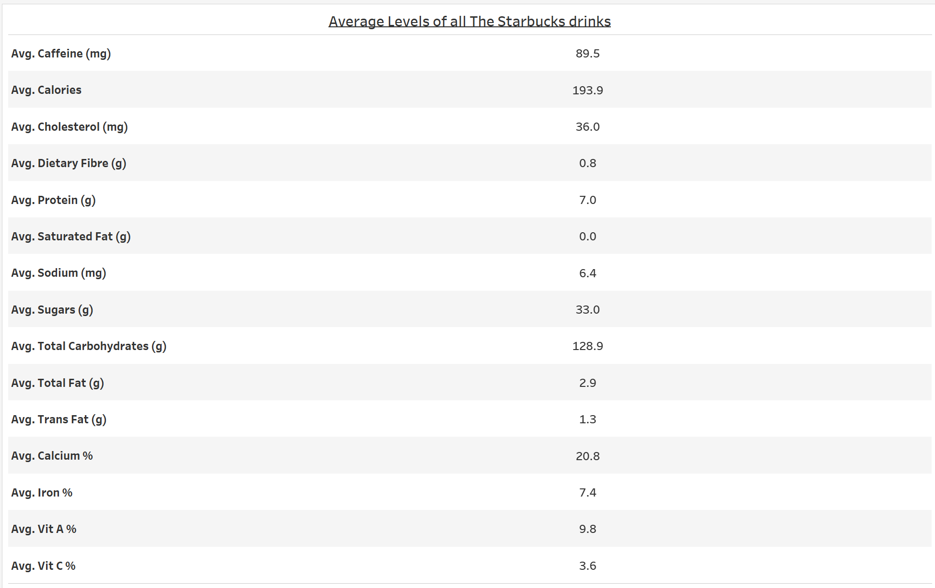
Average Levels of Nutrients of all the starbucks drinks

Slide 5
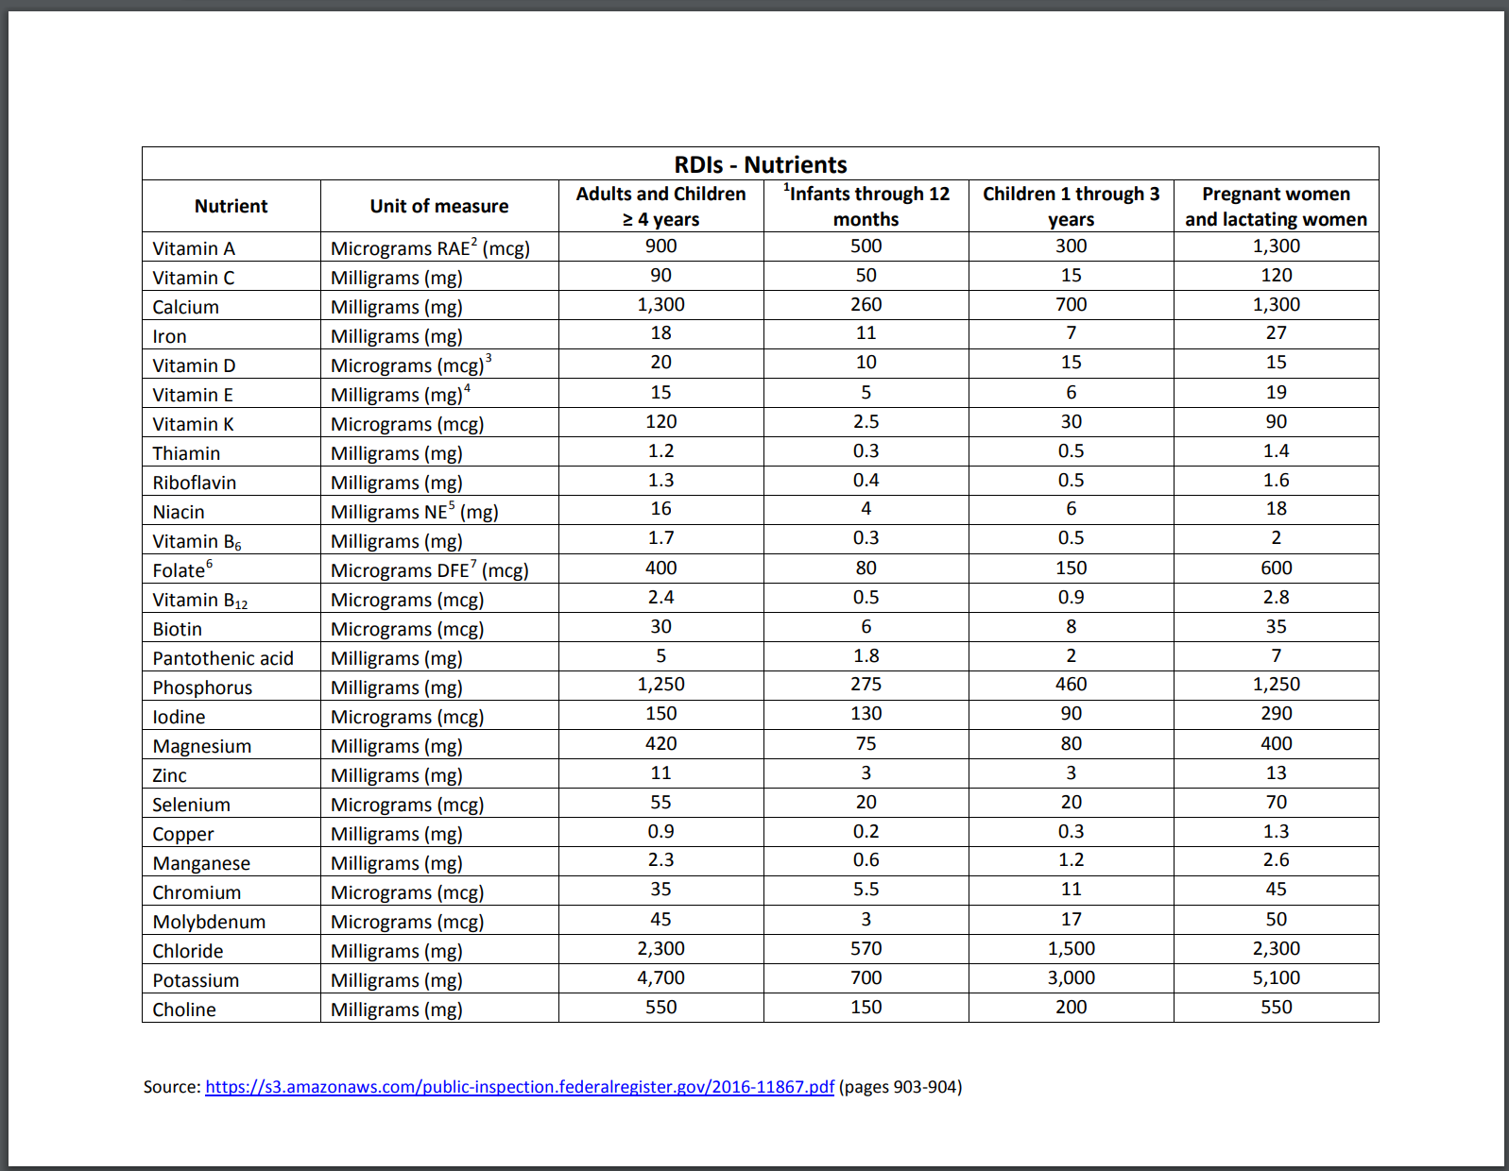
Threshold Levels of all the starbucks drinks *source ‘National Institutes of Health’

Slide 6
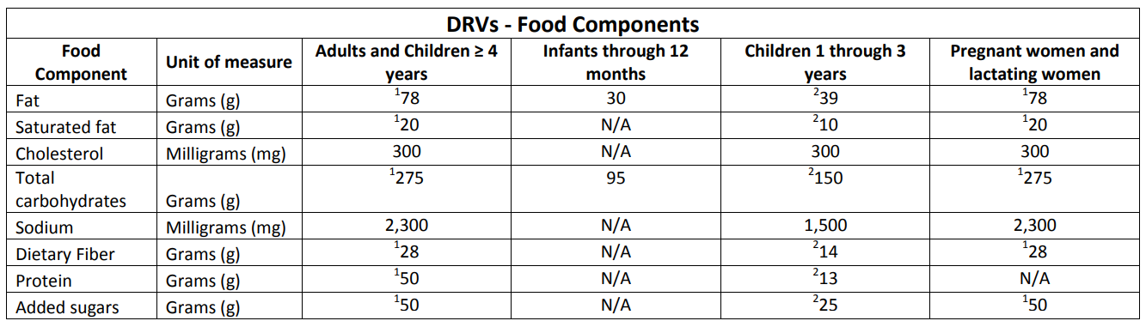
Threshold Levels of all the starbucks drinks *source ‘National Institutes of Health’

Slide 7
Comparison with Beverage Category on Daily Thresholds and

Slide 8
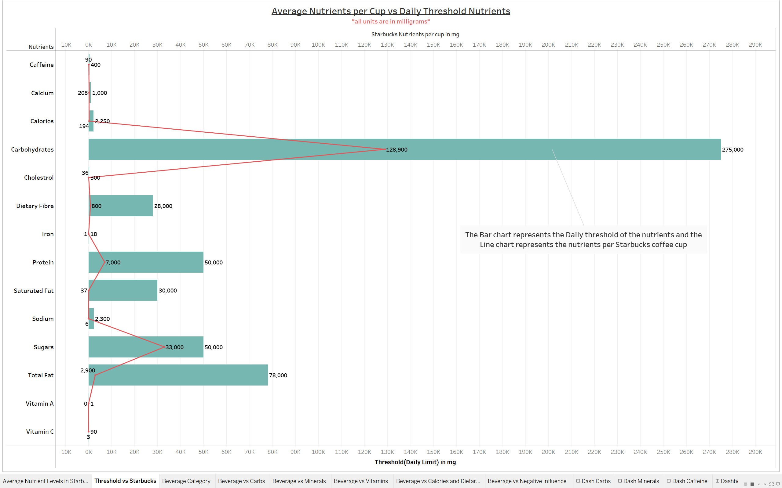
Threshold Levels of all the starbucks drinks

Slide 9
Starbucks Nutrients vs Daily Consumption limits
The comparison across various beverages with their nutrition content and the daily limits.

Slide 10
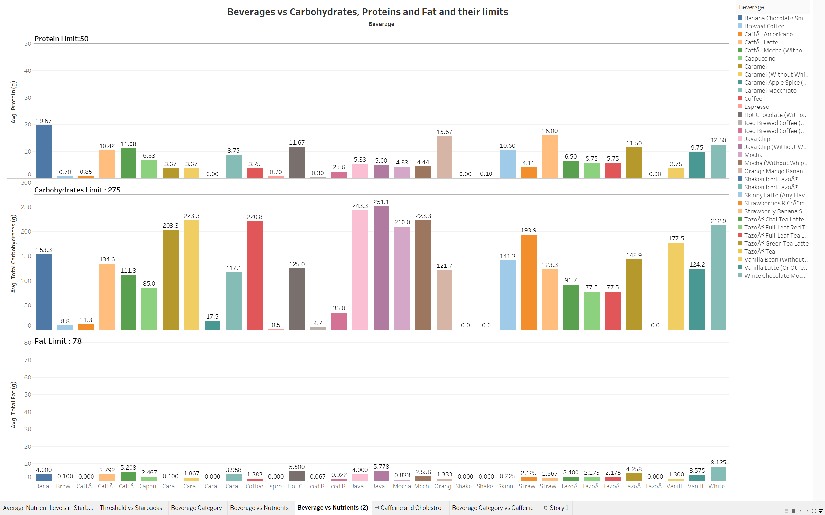
Daily Limits vs Starbucks Nutrients

Slide 11
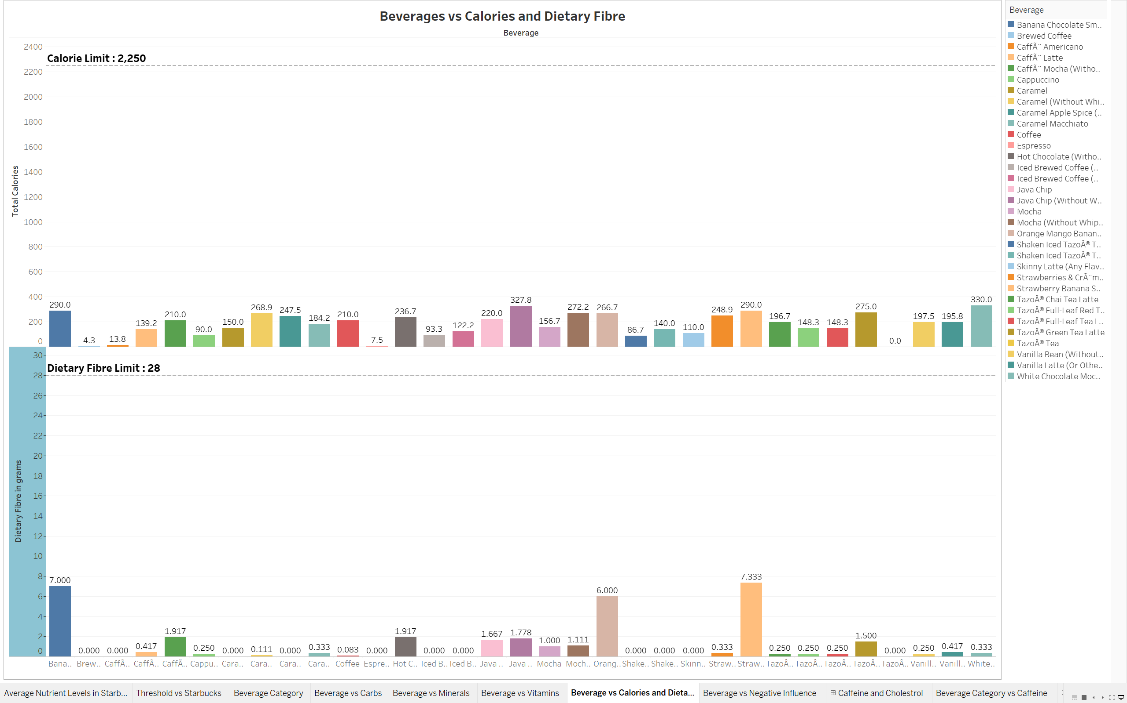
Daily Limits vs Calories and Dietary fiber

Slide 12
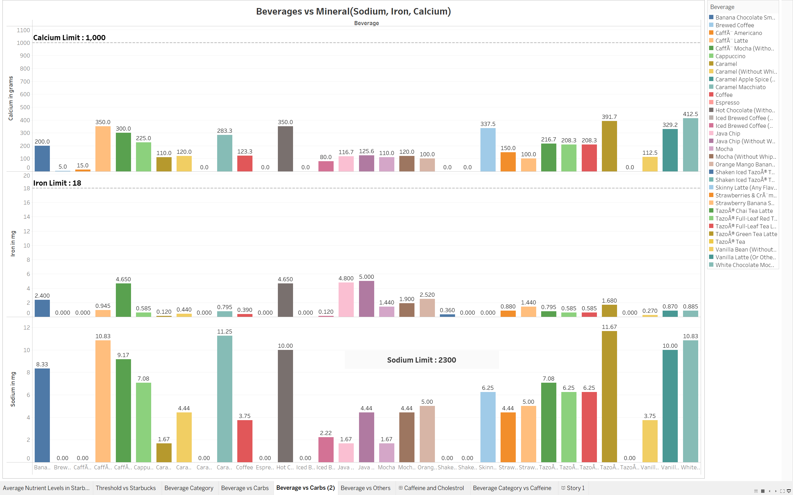
Daily LIMITS vs Starbucks Minerals

Slide 13
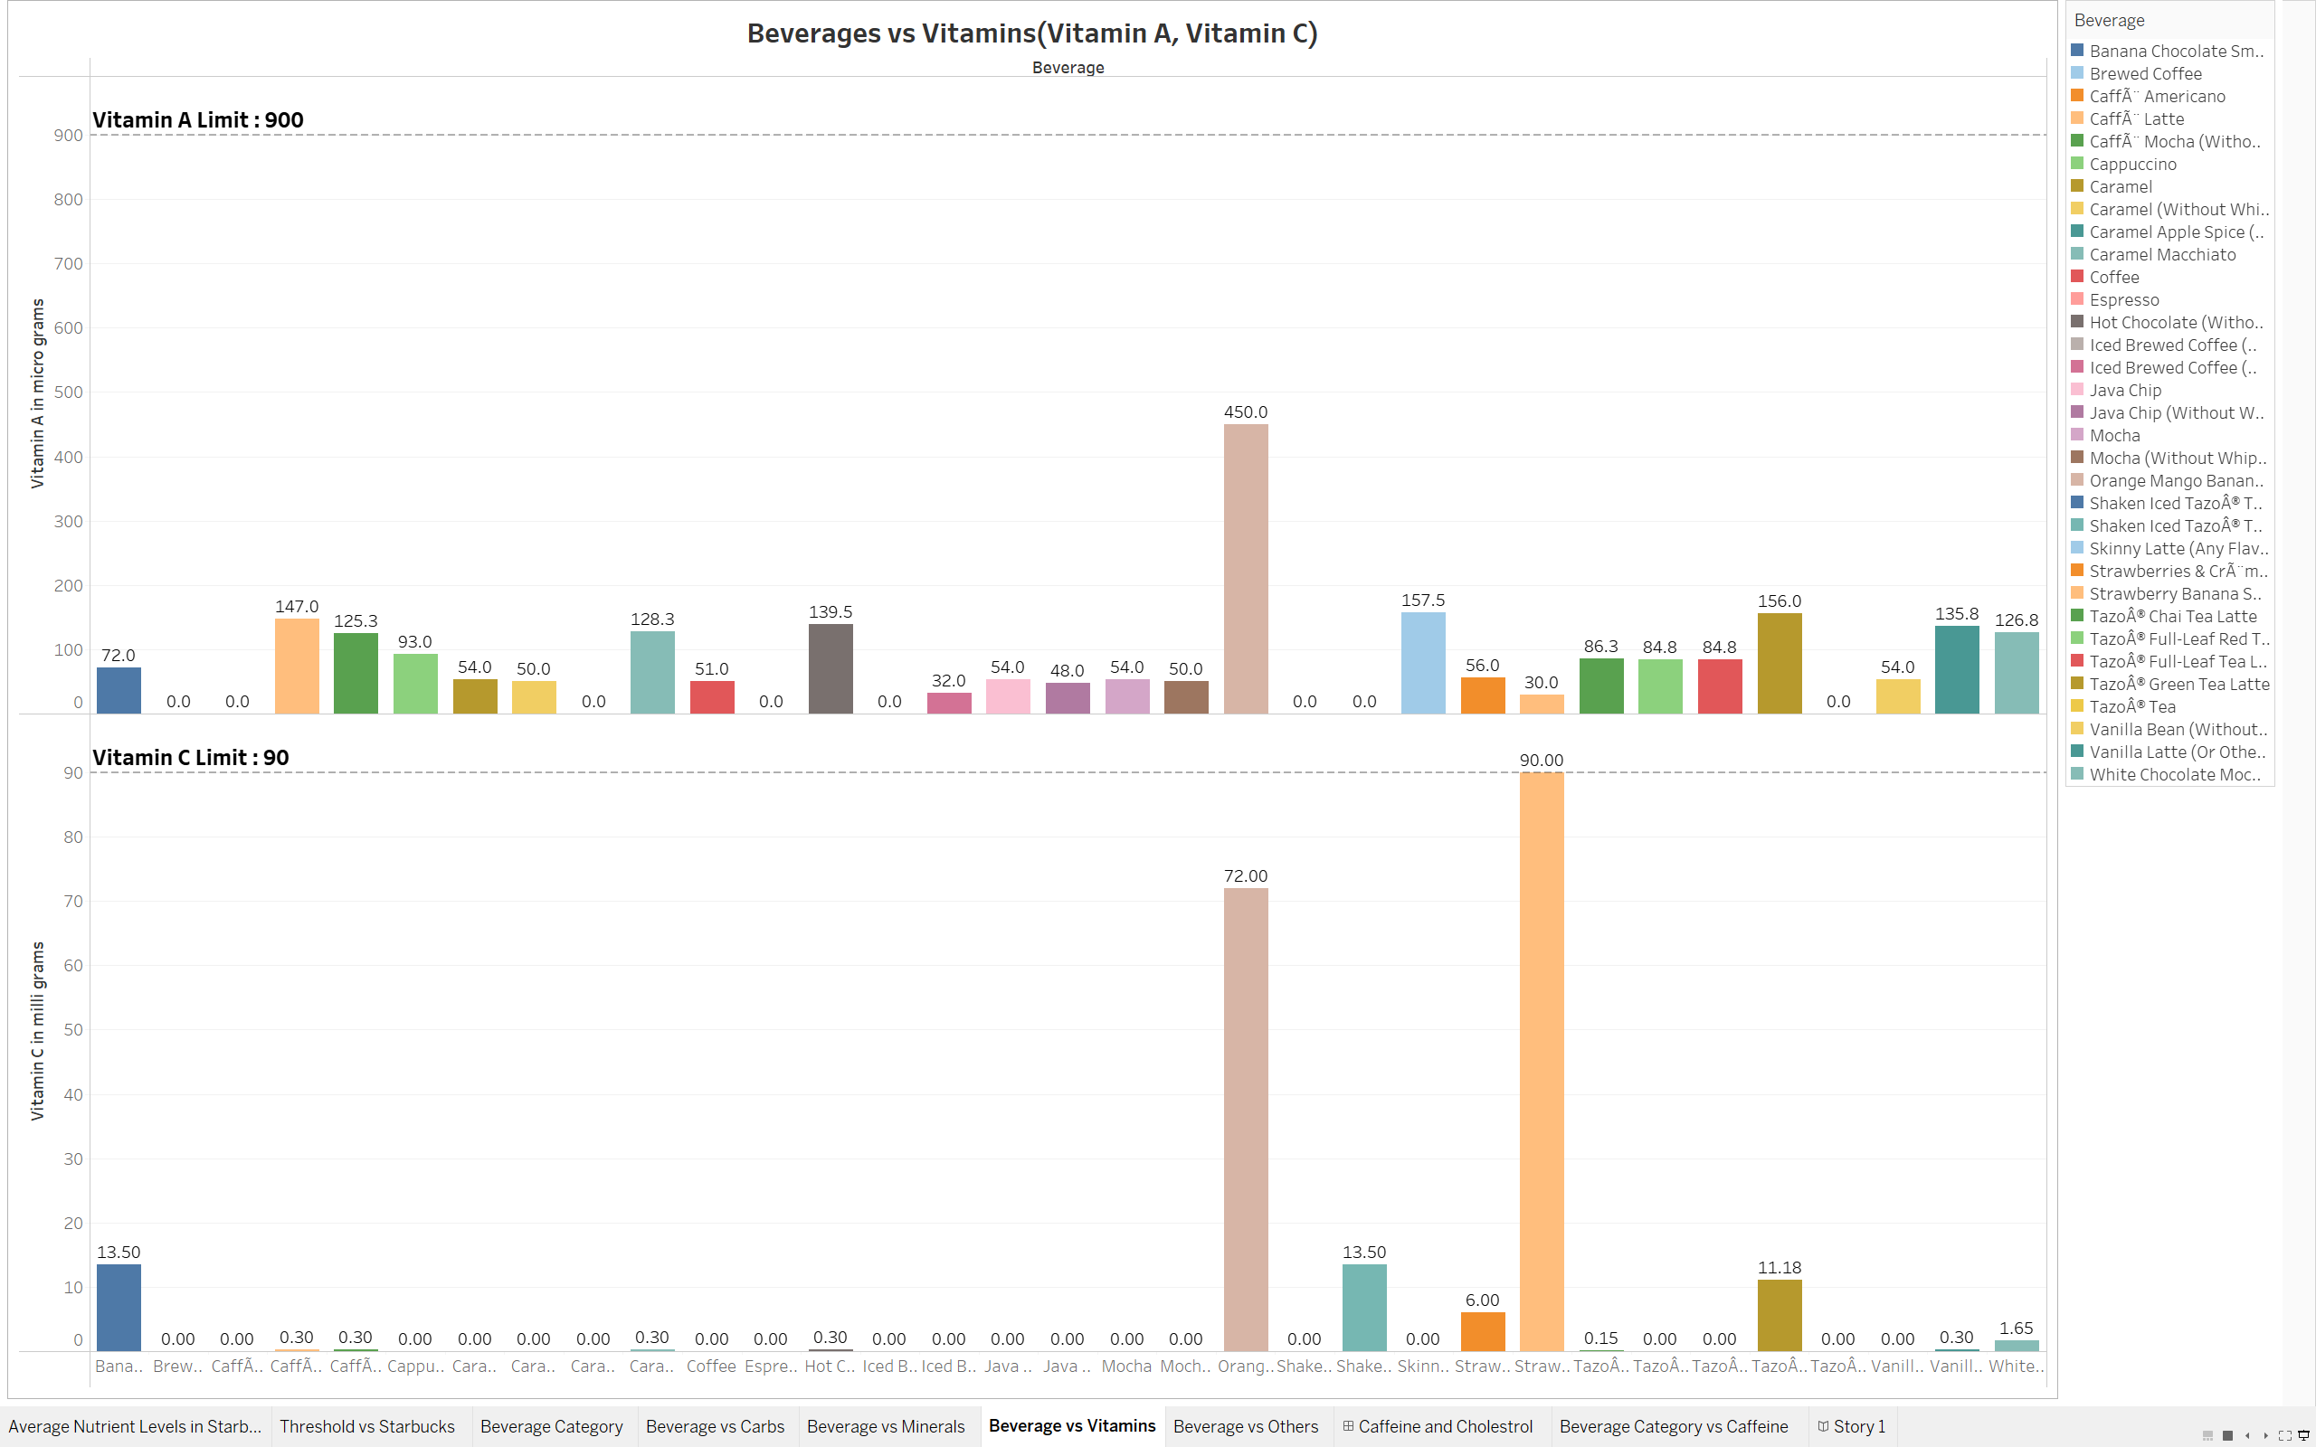
Daily Limits vs Vitamins

Slide 14
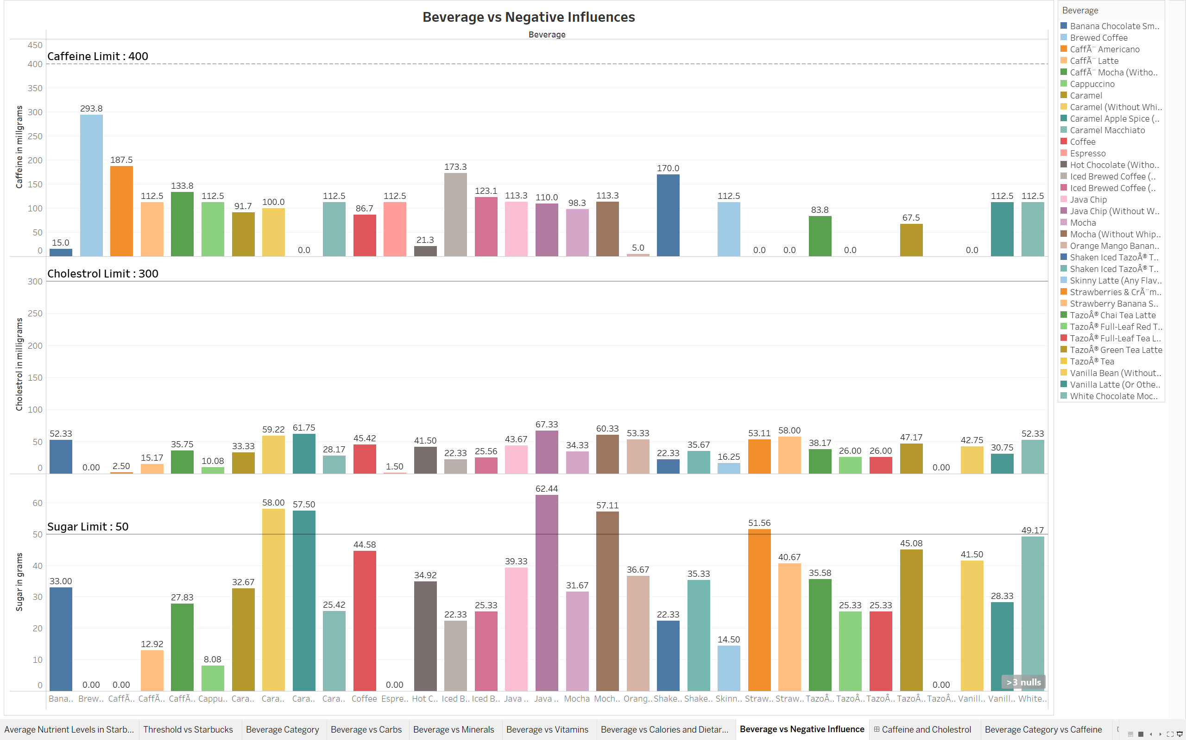
Daily Limits vs Other Nutrition Facts

Slide 15
Beverage and their nutrition information by their beverage category
Carbohydrates, Protein, Total Fat, Dietary Fiber and Calories
Minerals(Sodium, Calcium and Iron) and Vitamins(Vitamin A and Vitamin C)
Caffeine, Cholesterol and Sugar Levels

Slide 16
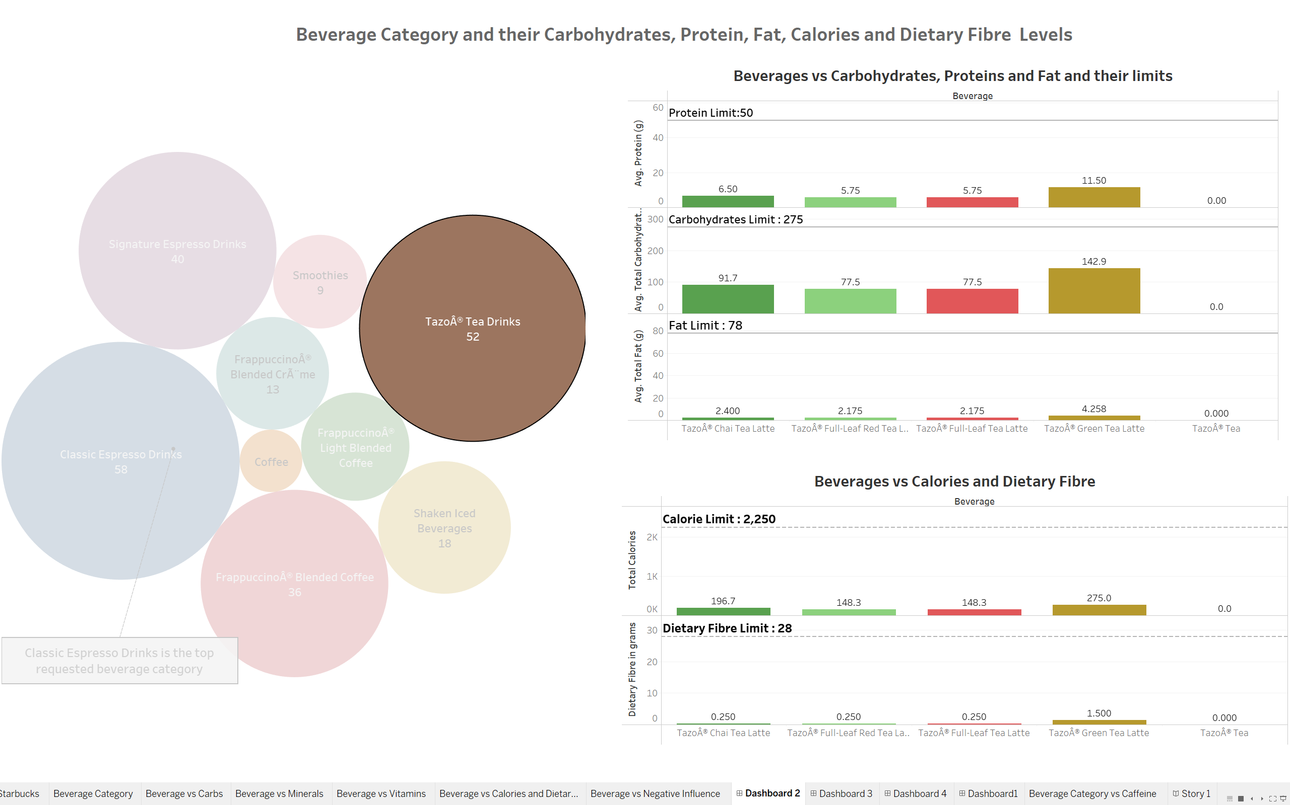
Beverage and their Nutrition facts

Slide 17
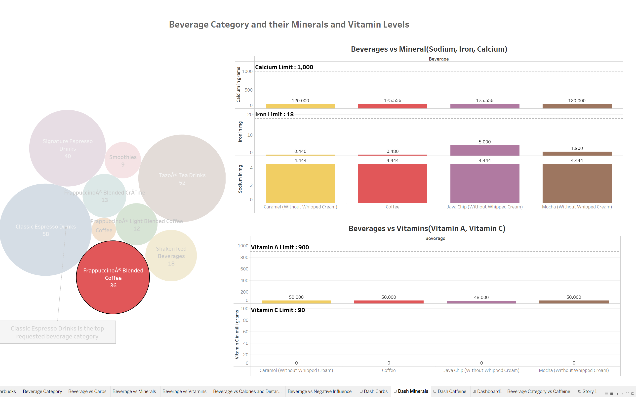
Beverage and their Nutrition facts

Slide 18
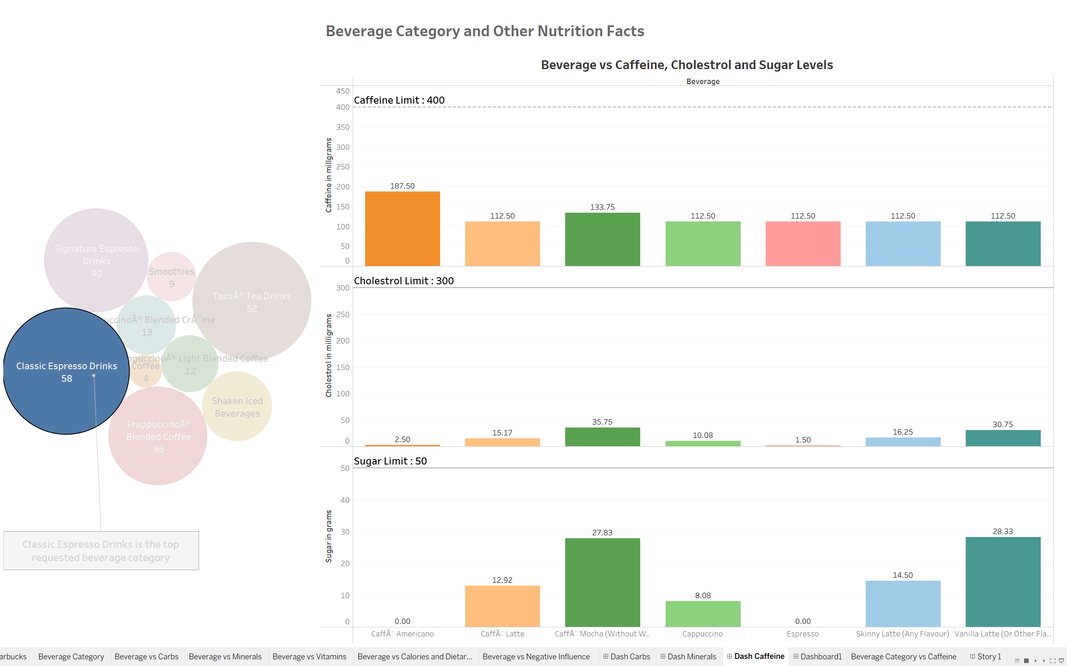
Beverage and their Nutrition facts

Slide 19
Conclusion
As shown the nutrition information of all the beverages in Starbucks.
All the beverages are in compliance with National Health Institutes
It is safe to conclude that 1-2 cups of Starbucks coffee wouldn’t be bad for health.

Slide 20
Thank You ☺ -Mohammed Ah Hassan Rayon Hussain

